Slide 1


WEEKEND
MEAL
SERVICE
For Food Service Managers

Slide 2


OVerview
This training will detail the following procedures:
Saturday Breakfast and Lunch services
Saturday Supper Field trips
Sunday Supper Field trips

Slide 3

CDE APPROVED
Saturday breakfast and lunch meals are mandated services pre-approved by the CDE for all main sites and off-sites.
Implementation can begin once the Request to Begin or Change Saturday Meal Service is completed and approved by the Food Services Division

Slide 4

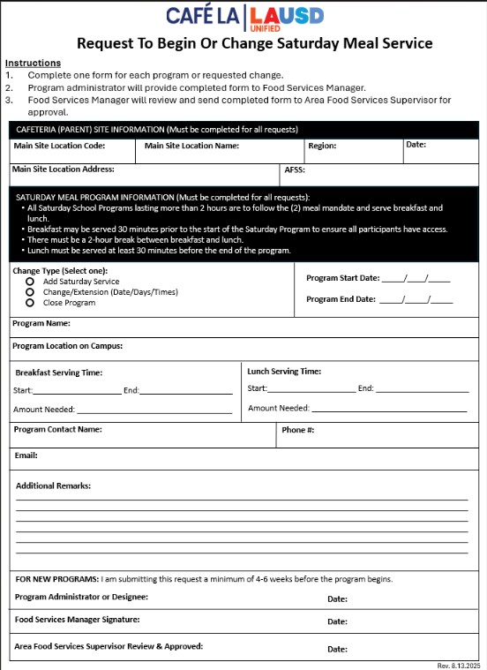
REQUEST TO BEGIN OR CHANGE SATURDAY MEAL SERVICE
A Request to Begin or Change Saturday Meal Service form must be completed by the Saturday Program Administration before the start of any Saturday program on site.
Must be submitted 4-6 weeks before program start date.
Once completed by the program administrator, form must be signed by the Food Service Manager (FSM) and Area Food Services Supervisor (AFSS) for approval.

Slide 5

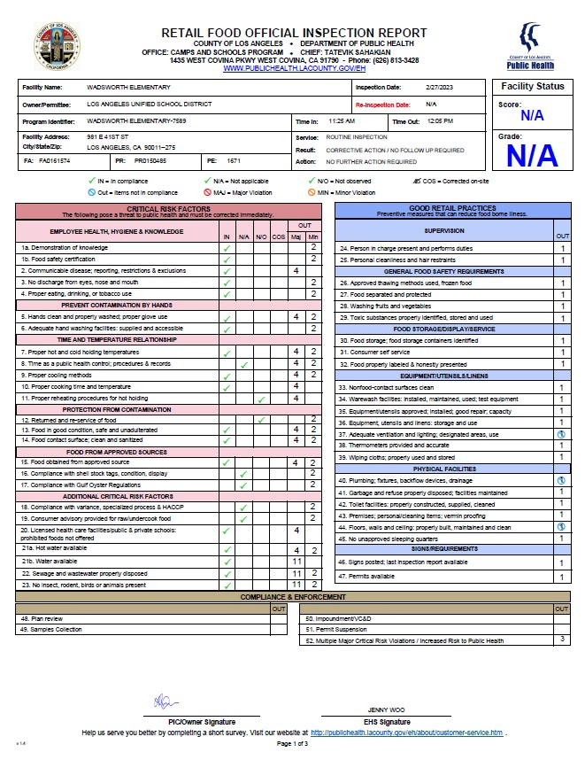
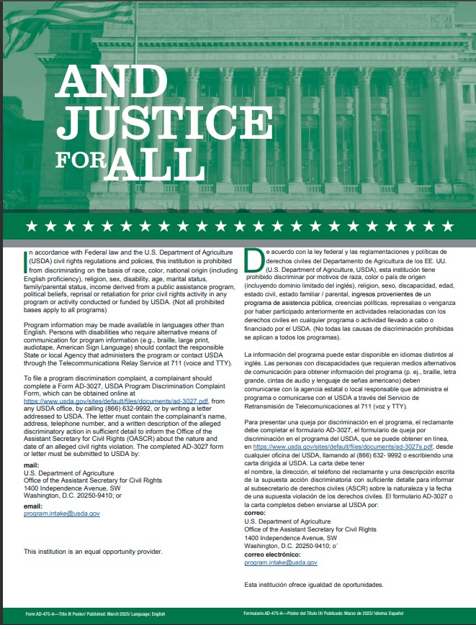
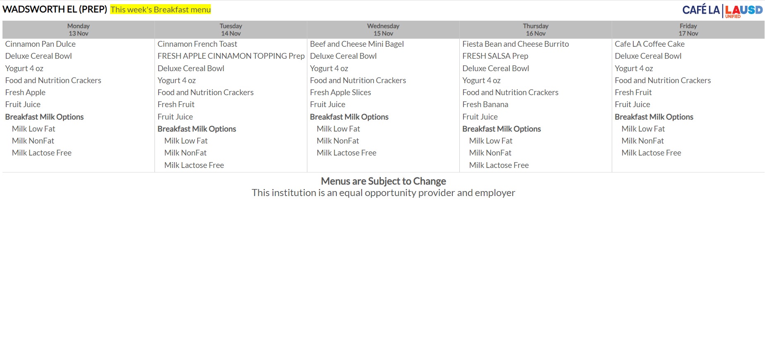
Mandatory Postings
The following forms and posters must be posted in an area visible by the general public for all weekend programs:
Current Health Inspection Report
Current “And Justice For All”
Saturday Service Menu

Slide 6
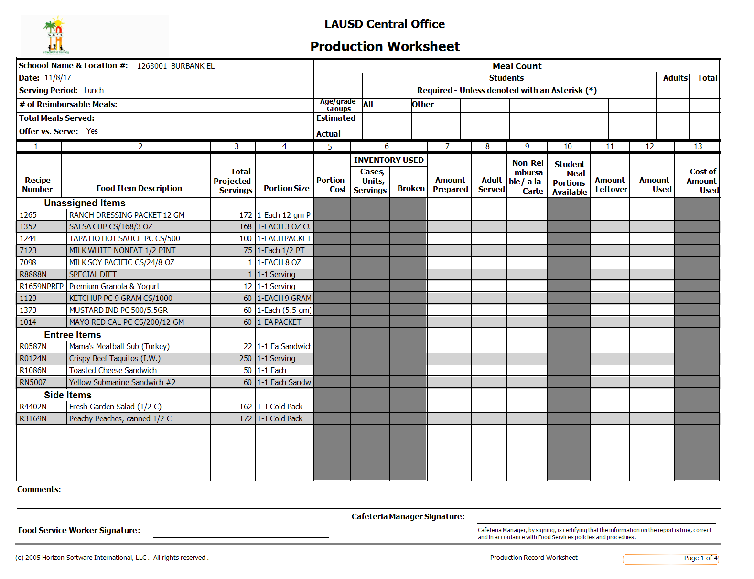
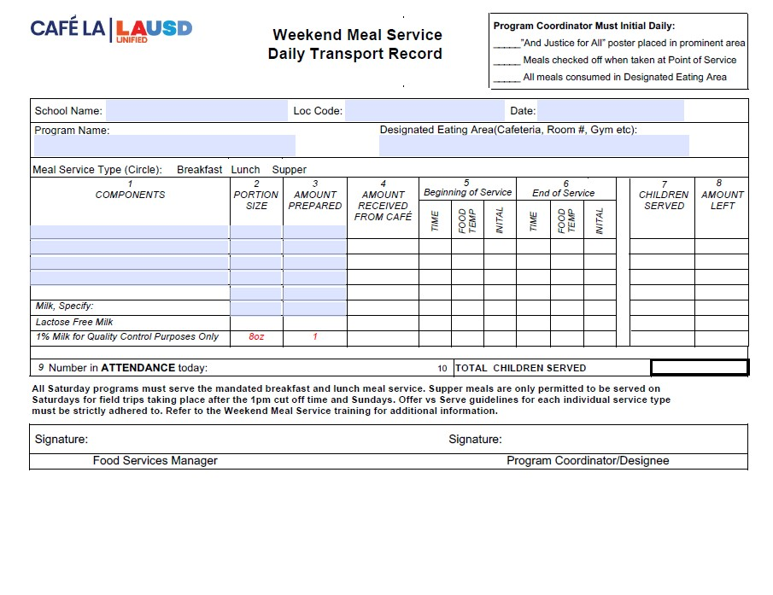
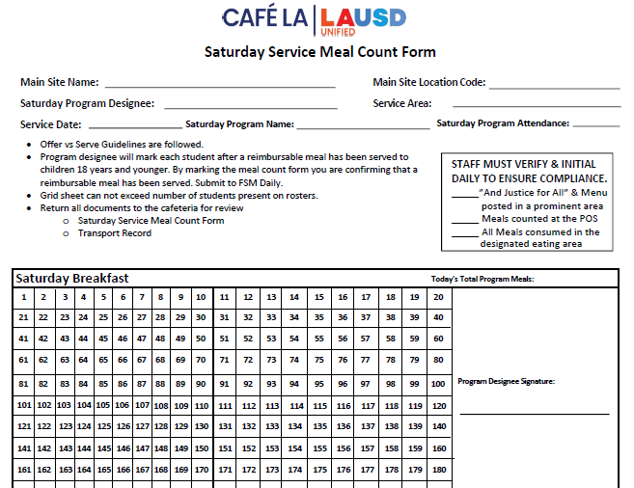
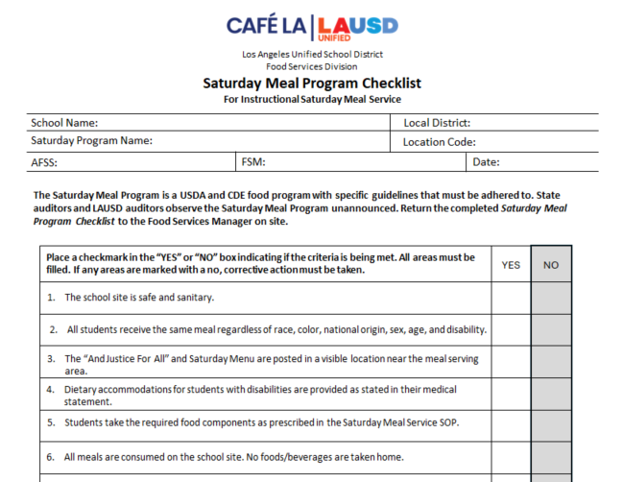
Saturday
Breakfast
&
Lunch Required Forms
1
2
Weekend Meal Service
Daily Transport Record
Completed Daily
Production Record
Inputted the Monday after service
3
4
Saturday Meal Count form
Completed Daily
Saturday Meal Service Checklist
Completed within
first 4 months of program

Slide 7
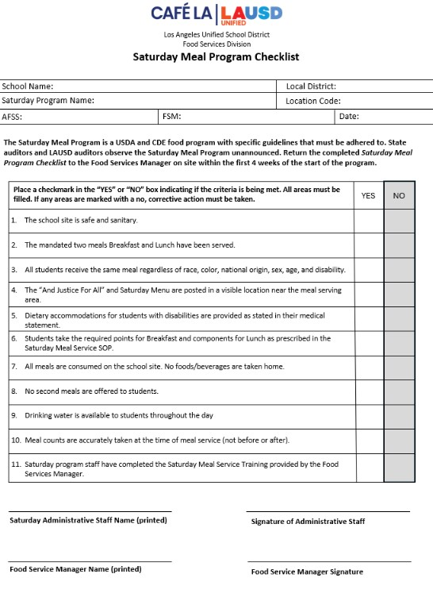

Saturday Meal Service Checklist
The Saturday Meal Service Checklist is for all Saturday School programs.
Check list must be completed within the first 4 weeks of the Saturday program by the Saturday program administration
This ensures all Saturday programs are in CDE compliance

Slide 8
WEEKEND DAILY TRANSPORT RECORD
Daily transport records are used whenever food is being served outside of FSD hands.
FSM will pre-fill the header with the school name, location code, date, ect.

Slide 9
WEEKEND DAILY TRANSPORT RECORD
Daily transport records are used whenever food is being served outside of FSD hands.
FSM will then pre-fill all components, portion sizes, the amount prepared and circle the meal service being served .

Slide 10
WEEKEND DAILY TRANSPORT RECORD
Daily transport records are used whenever food is being served outside of FSD hands.
Once received from the cafeteria Program staff will fill in amounts for:
Amount received
Time and Temperature of each food item at the beginning and end of service. Initialing each item
Children served
Amount leftover

Slide 11
WEEKEND DAILY TRANSPORT RECORD
Daily transport records are used whenever food is being served outside of FSD hands.
At the end of service, Saturday Program Staff will record the total attendance and total children served reimbursable meals

Slide 12
WEEKEND DAILY TRANSPORT RECORD
Daily transport records are used whenever food is being served outside of FSD hands.
Before returning the Weekend Meal Service Daily Transport Record, Saturday program staff will sign. Verifying all information is true and correct.

Slide 13
WEEKEND DAILY TRANSPORT RECORD
Daily transport records are used whenever food is being served outside of FSD hands.
FSM will sign once the transport record is completed and returned, signifying the information is true and correct.

Slide 14
SATURDAY
SERVICE MEAL COUNT FORM
The Saturday Service Meal Count Form will be used for Saturday breakfast and lunch only.
Saturday field trips that take place before the 1pm cut off time will serve the mandated breakfast and lunch in accordance with CDE guidelines

Slide 15
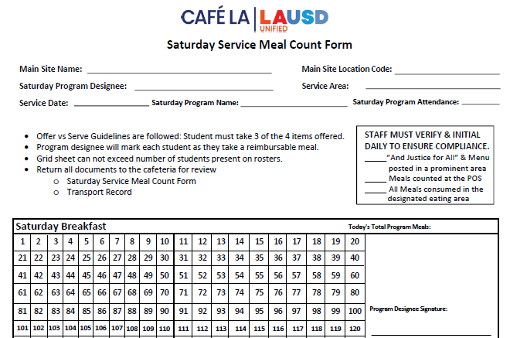
SATURDAY SERVICE MEAL COUNT REPORT
continued
FSM will complete the header portion for:
Main site name
Main site location

Slide 16
SATURDAY SERVICE MEAL COUNT REPORT
continued
Program staff will complete the remaining portions of header. Including initialing the daily compliance box in the right-hand corner of the form.

Slide 17
SATURDAY SERVICE MEAL COUNT REPORT
continued
Program Staff will then mark off each student as they receive a reimbursable meal on the grid portion of the form.

Slide 18
SATURDAY SERVICE MEAL COUNT REPORT
continued
Number of reimbursable meals served must not exceed the amount of attendance.

Slide 19
SATURDAY SERVICE MEAL COUNT REPORT
continued
Once service has ended. Program Staff will sign verifying all information is true and correct.

Slide 20
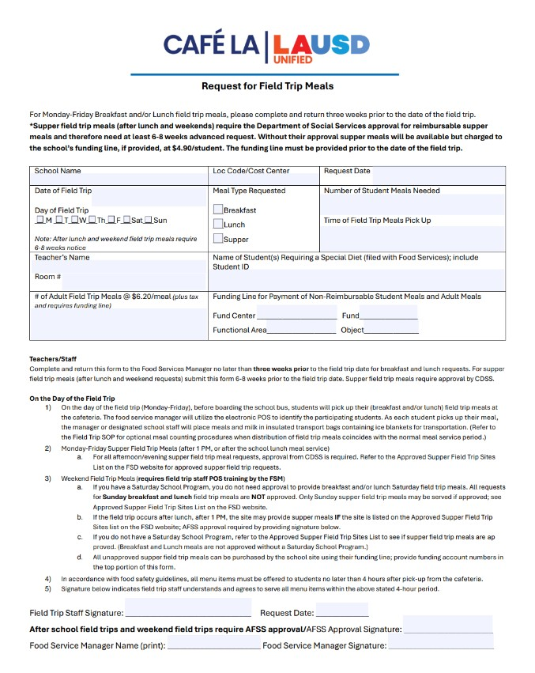
WEEKEND FIELD TRIPS
When requesting Saturday or Sunday field trips, program staff are required to complete the Request for Field Trip Meals form 6-8 weeks prior to the field trips date.

Slide 21
WEEKEND FIELD TRIPS
If you do NOT have a Saturday School Program you will require AFSS approval to serve Saturday or Sunday field trip meals.
AFSS’s and FSM’s are to refer to the food services website for approved Saturday programs
For additional information contact the Food Services Regional Manager.

Slide 22
WEEKEND FIELD TRIPS
*Schools with an already approved Saturday Program are pre-approved for field trip meals. However, the Request For Field Trip Meals form is still required to notify managers of serving amounts and planning purposes*

Slide 23
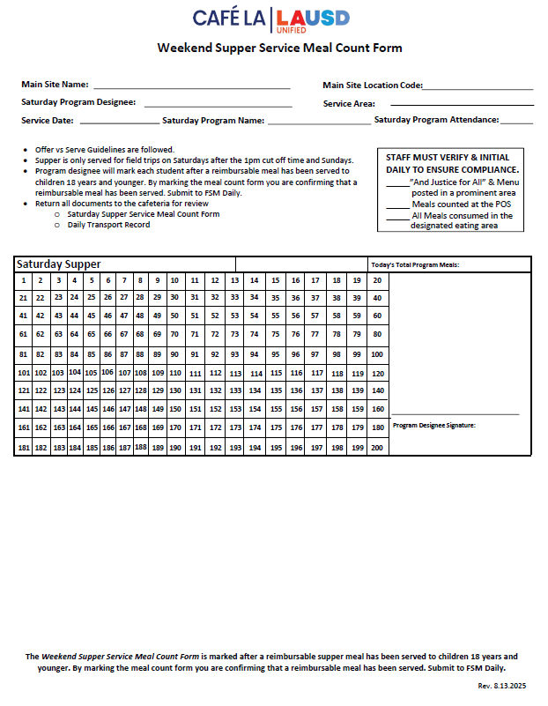
WEEKEND SUPPER SERVICE MEAL COUNT FORM
The Weekend Supper Service Meal Count Form is required for all:
Saturday field trips that take place after the 1pm cut off time
Sunday field trips requiring a meal

Slide 24
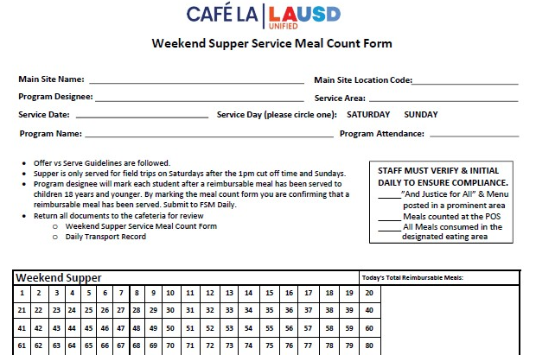
WEEKEND SUPPER MEAL COUNT FORM
FSM will fill in the Main site and main site location before leaving the form for program staff.

Slide 25
WEEKEND SUPPER MEAL COUNT FORM
Program staff must ensure the service date is entered and the service day has been circled, along with all other header information.

Slide 26
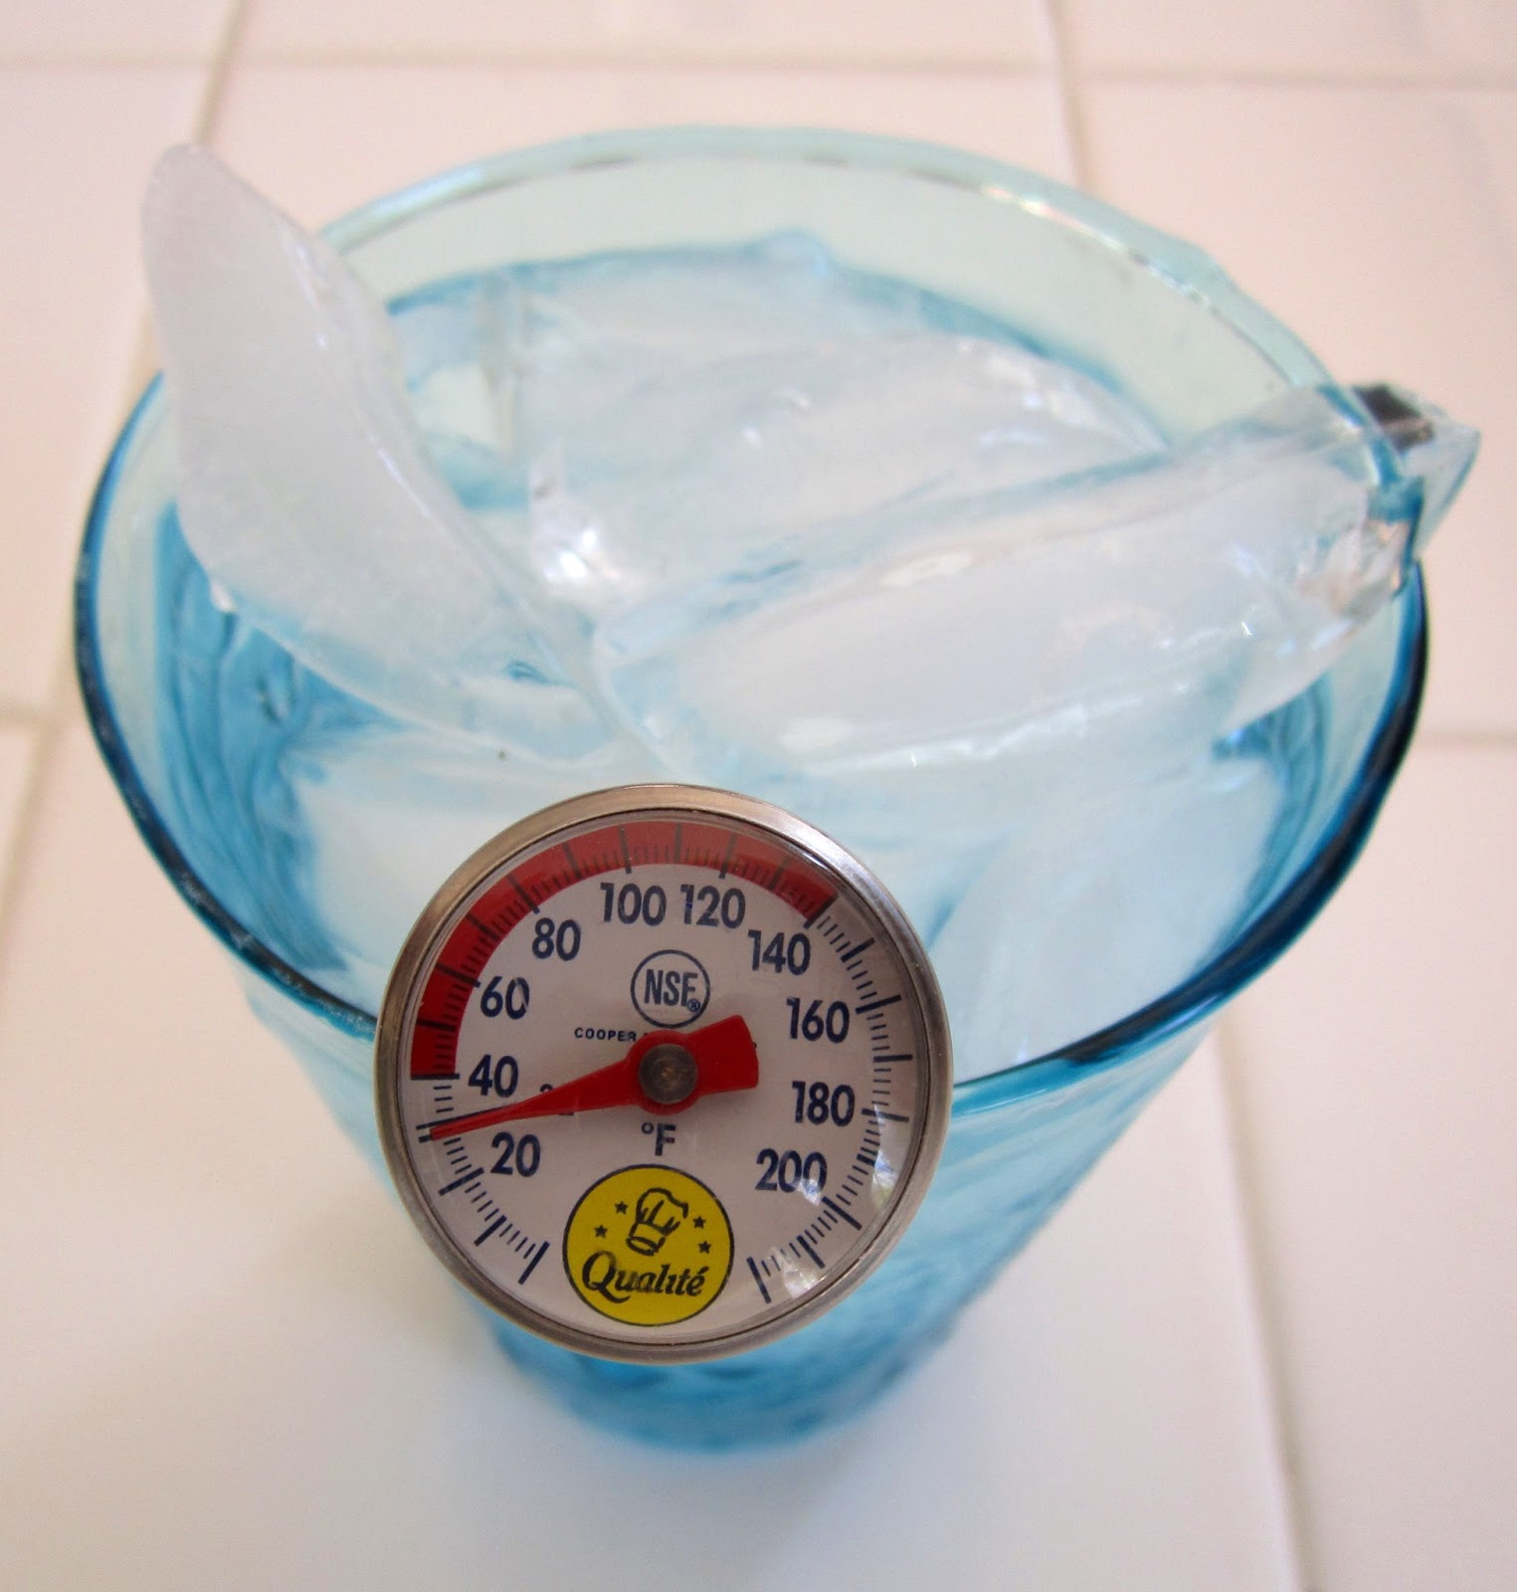
HACCP Guidelines
FSD Staff and Saturday Program Staff are required to follow all HACCP guidelines.
Food Service Manager will leave Saturday Service Menu items in an accessible refrigerator unit for Saturday program staff
Three(3) clean, sanitized, and calibrated thermometers will be provided by the Food Services Manager to Saturday Program Staff along with sanitation wipes.
ALL potentially hazardous items, hot and cold, must be temped and recorded onto the Weekend Meal Service Daily Transport Record.
The Food Service Manager will add one carton of milk for temperature-taking purposes.

Slide 27
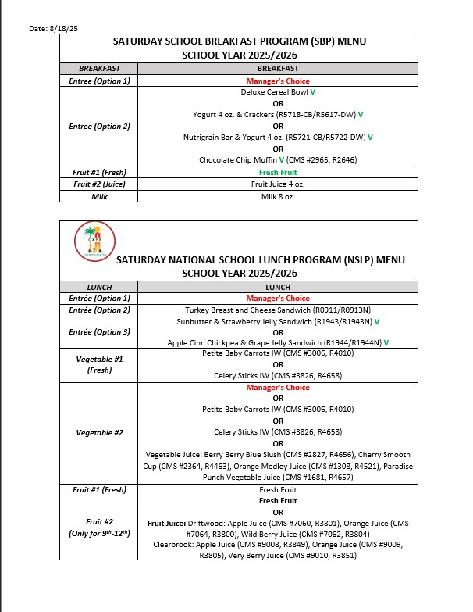
MENU’S AT A GLANCE
The Saturday Breakfast and Lunch Menu can be found on the FSD webpage under the “Menu” tab > sub section “Other Menus”.

Slide 28
MENU AT A GLANCE
The FSM will choose from the entrée options provided on the Saturday Breakfast and Lunch menu. Only one Entrée Option will be chosen.

Slide 29




MENU AT A GLANCE
Once the FSM has chosen an Entrée Option. They will then choose a popular option they would like to serve. For instance:
OR
OR
Deluxe Cereal Bowl
Yogurt & Crackers
Nutri-grain Bar
DO NOT SERVE ALL OPTIONS

Slide 30
MENU AT A GLANCE
Only ONE Entrée must be served for Breakfast and Lunch

Slide 31
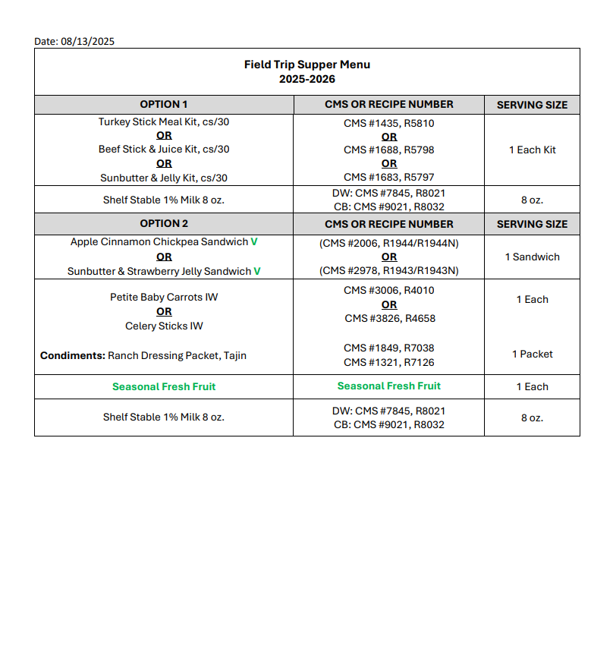
WEEKEND SUPPER FIELD TRIP MENU
FSM will refer to the Field Trip Supper Menu for all fieldtrips taking place:
Saturdays after the 1pm cut off time
Sundays

Slide 32
WEEKEND SUPPER FIELD TRIP MENU
All weekend field trips that fall under these categories will receive shelf stable milk in place of perishable milk.

Slide 33



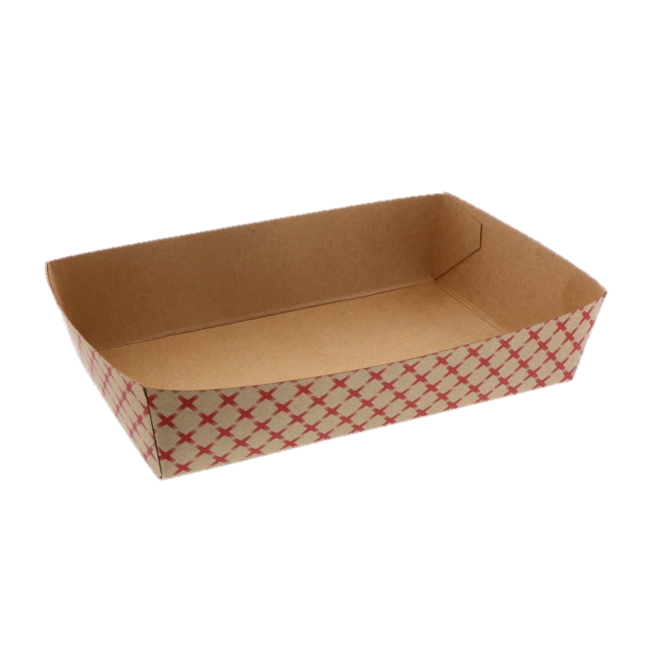


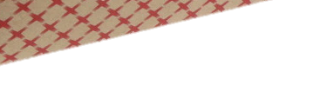
OFFER VS SERVE
In an effort to reduce waste all instructional Saturday programs will follow Offer vs Serve guidelines for all meal services:
Saturday Breakfast
Student must take 3 or more points; one must be a fruit.
Saturday Lunch
Student must take 3 components
One component MUST be a fruit or vegetable.

Slide 34
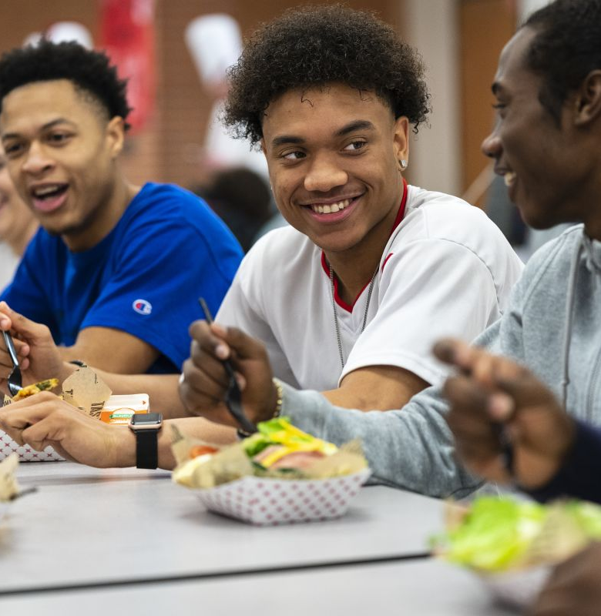
After Service Overview

Slide 35

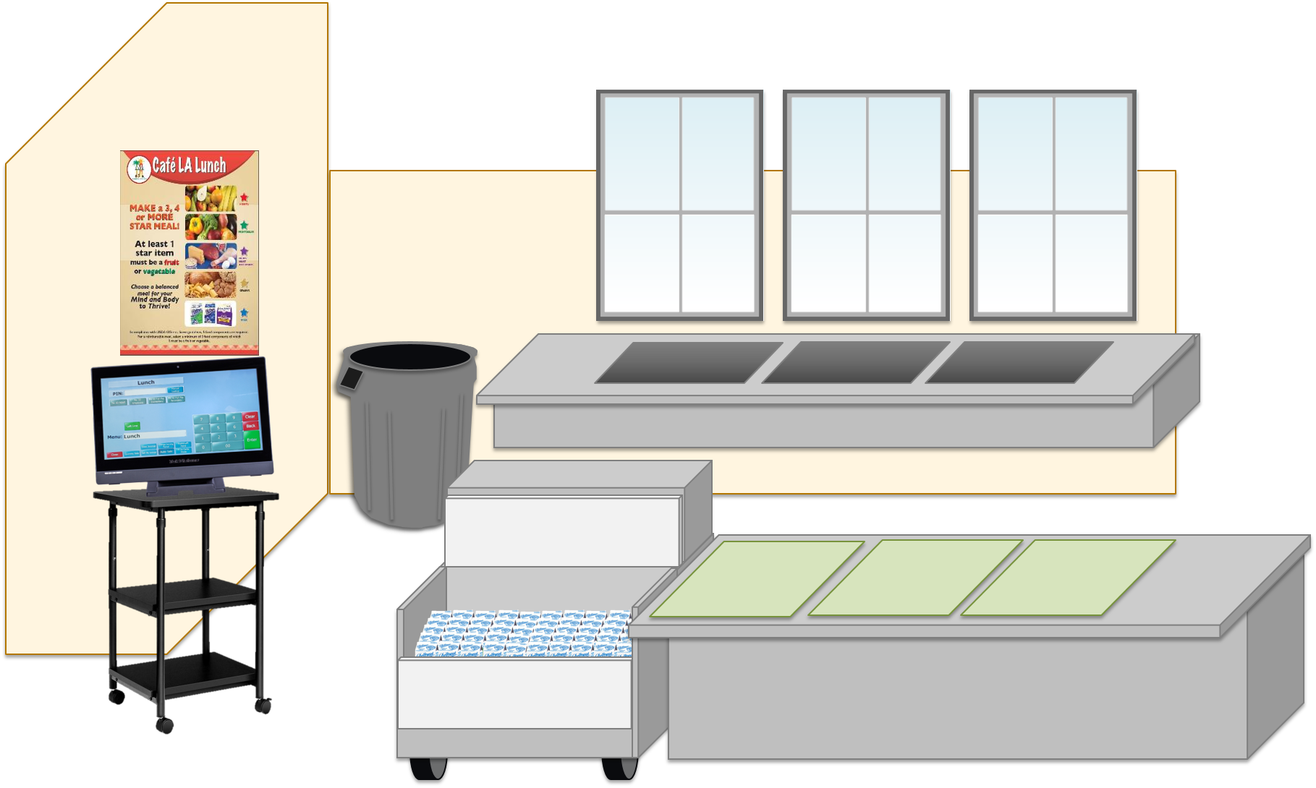
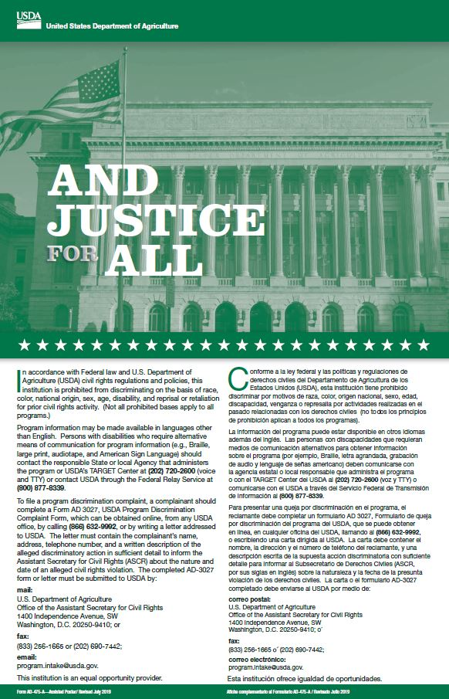
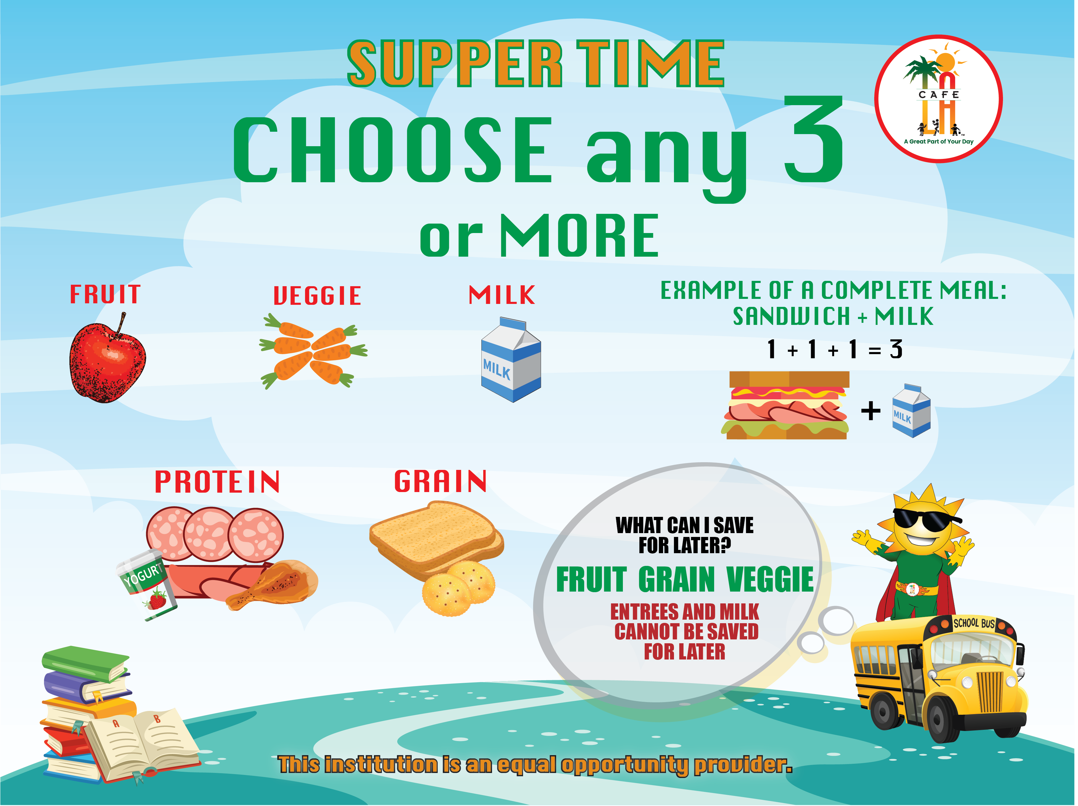
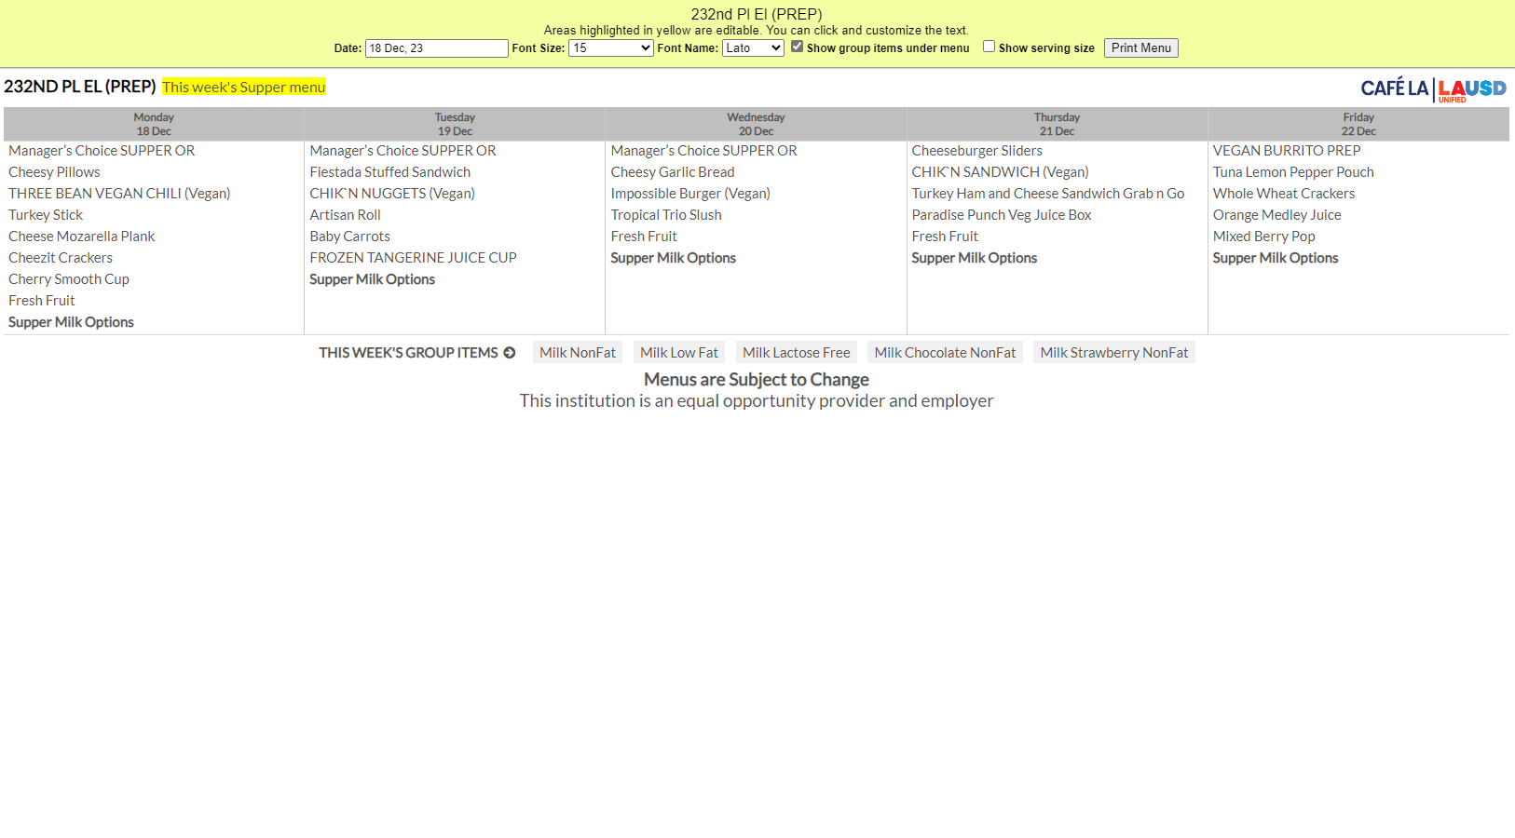


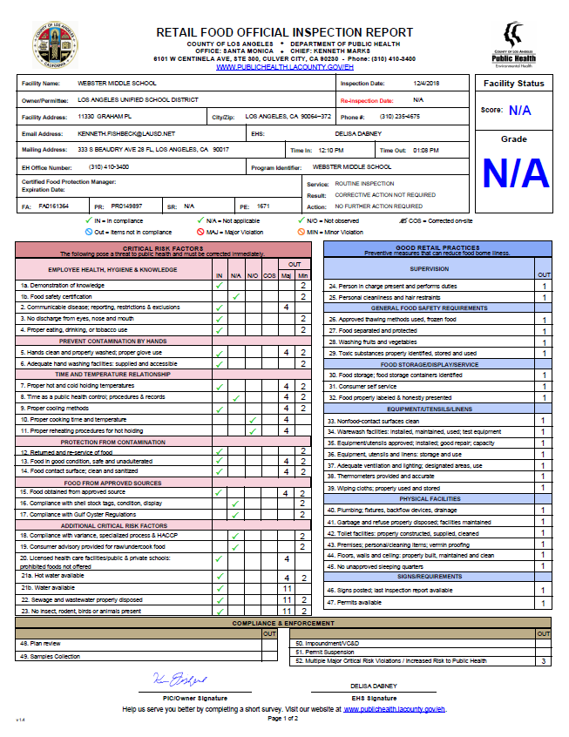


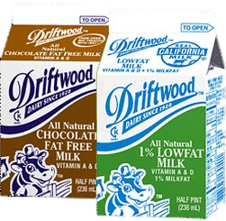


Saturday Program staff will leave all left over items in the designated refrigeration unit for pick up on the following Monday
Only whole untampered with fruits and non-perishable items will be returned to stock.
All other items will be discarded
Return to Stock
Discard

Slide 36







Once I’ve discarded all perishable items. I can now enter my productions and daily entry.
Queen Bee designs

Slide 37

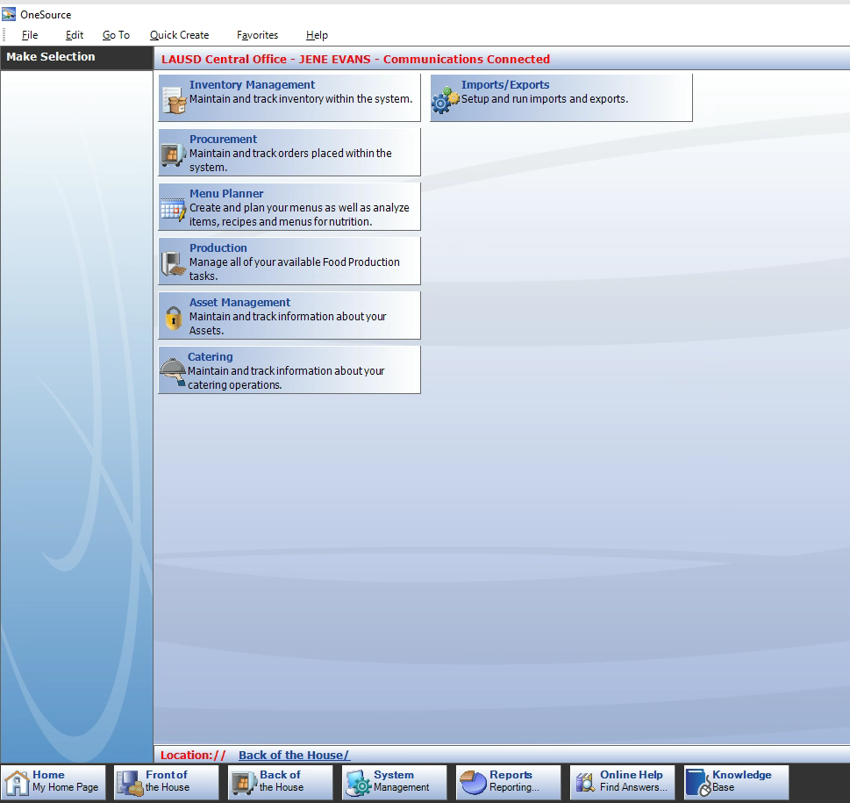
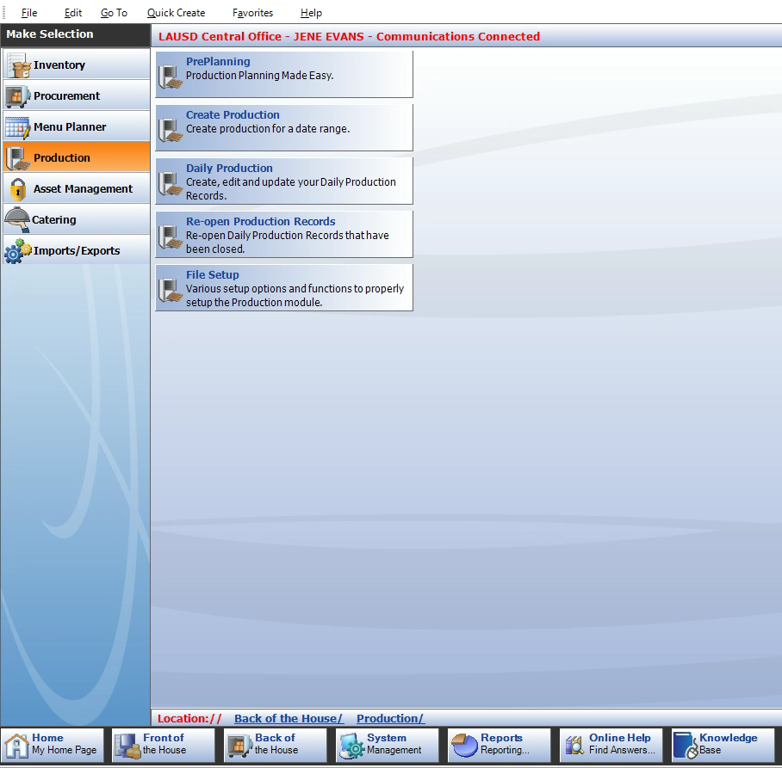
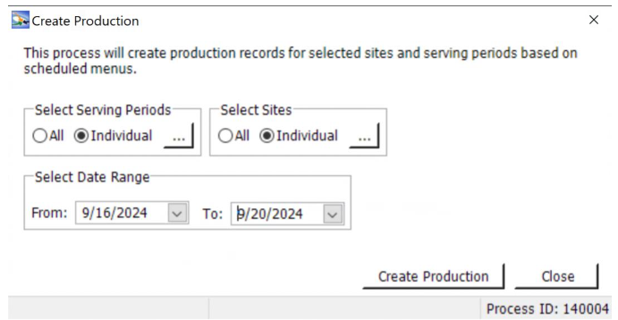
Creating Saturday Productions
Production Records must be created for all Saturday Programs and all serving periods under main site.
Go to Back of House.
Click Productions.
Click Create Productions.
Next in the “select serving periods” area click individual, then select the serving period to create.
Then in the “ select site” area click individual, then choose the main site.
Select the date you would like to create.
Finally select Create Productions to create the Saturday productions for the site.

Slide 38
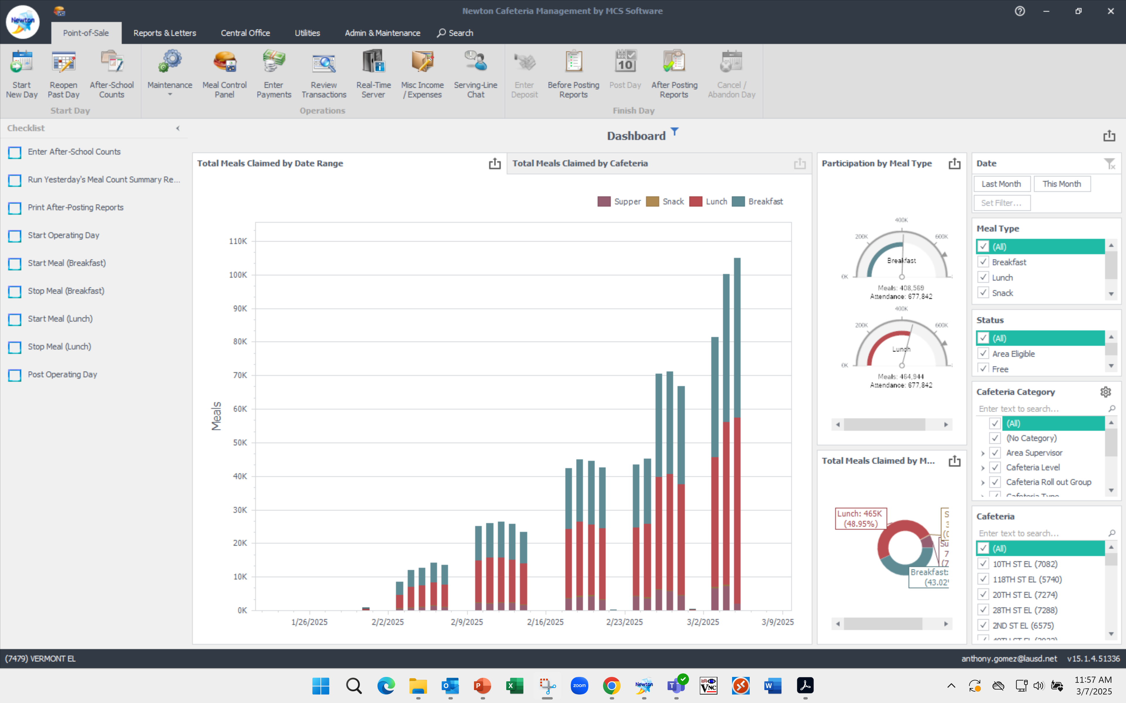
ENTERING MEALS IN NEWTON
The following Monday after Saturday Meal Service, the Food Service Manager will enter all meal counts.

Slide 39
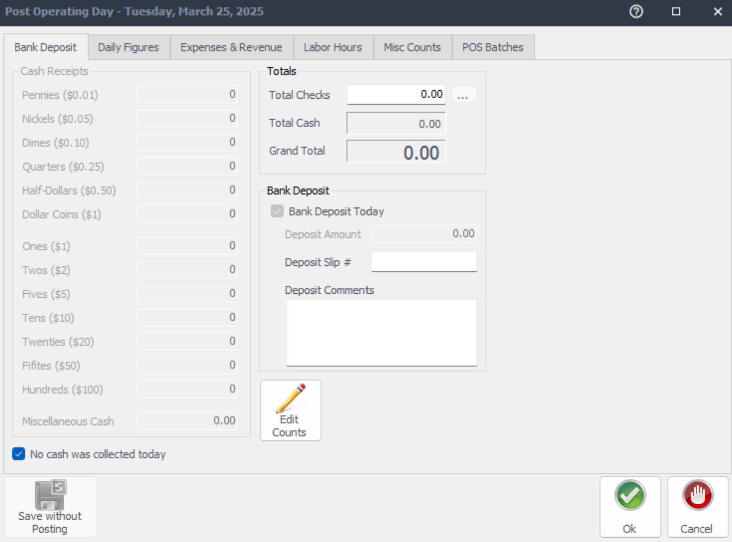
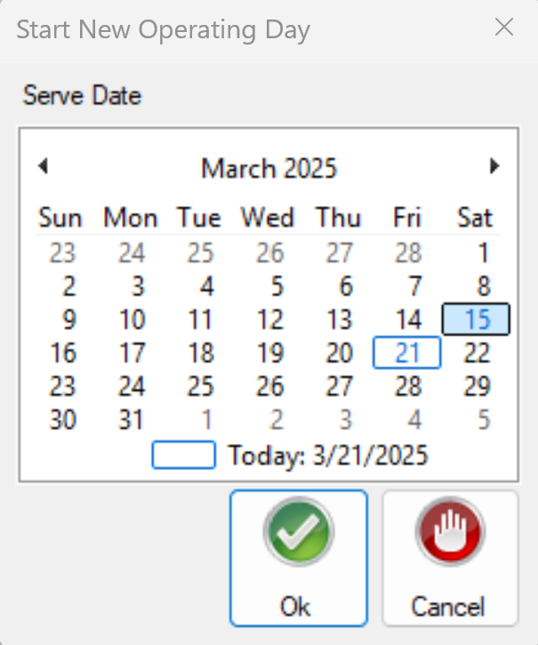
ENTERING MEALS IN NEWTON
Click Start Operating Day (checklist)
Choose the date you would like to open
Select post operating day)Bank Deposit Tab will open.

Slide 40
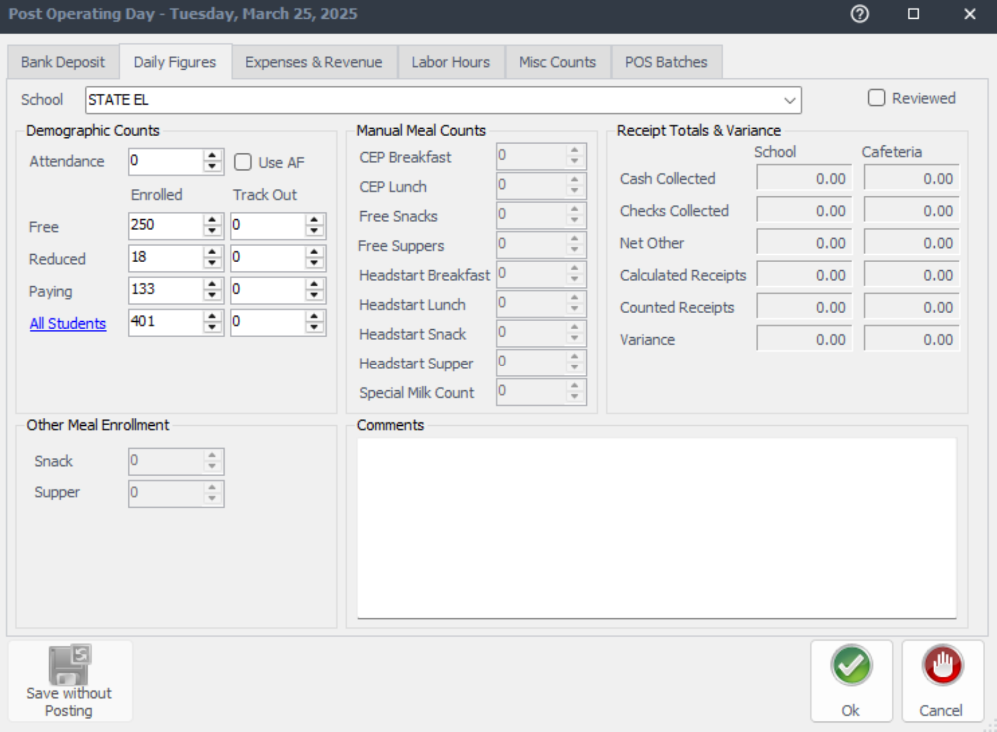
ENTERING MEALS IN NEWTON
Add Deposit, if no money was collected select the “No cash was collected today” checkbox
Open the Daily Figures Tab ( do misc counts first)
Enter Attendance under the Main Site. Use the past Friday’s enrollment and attendance.

Slide 41
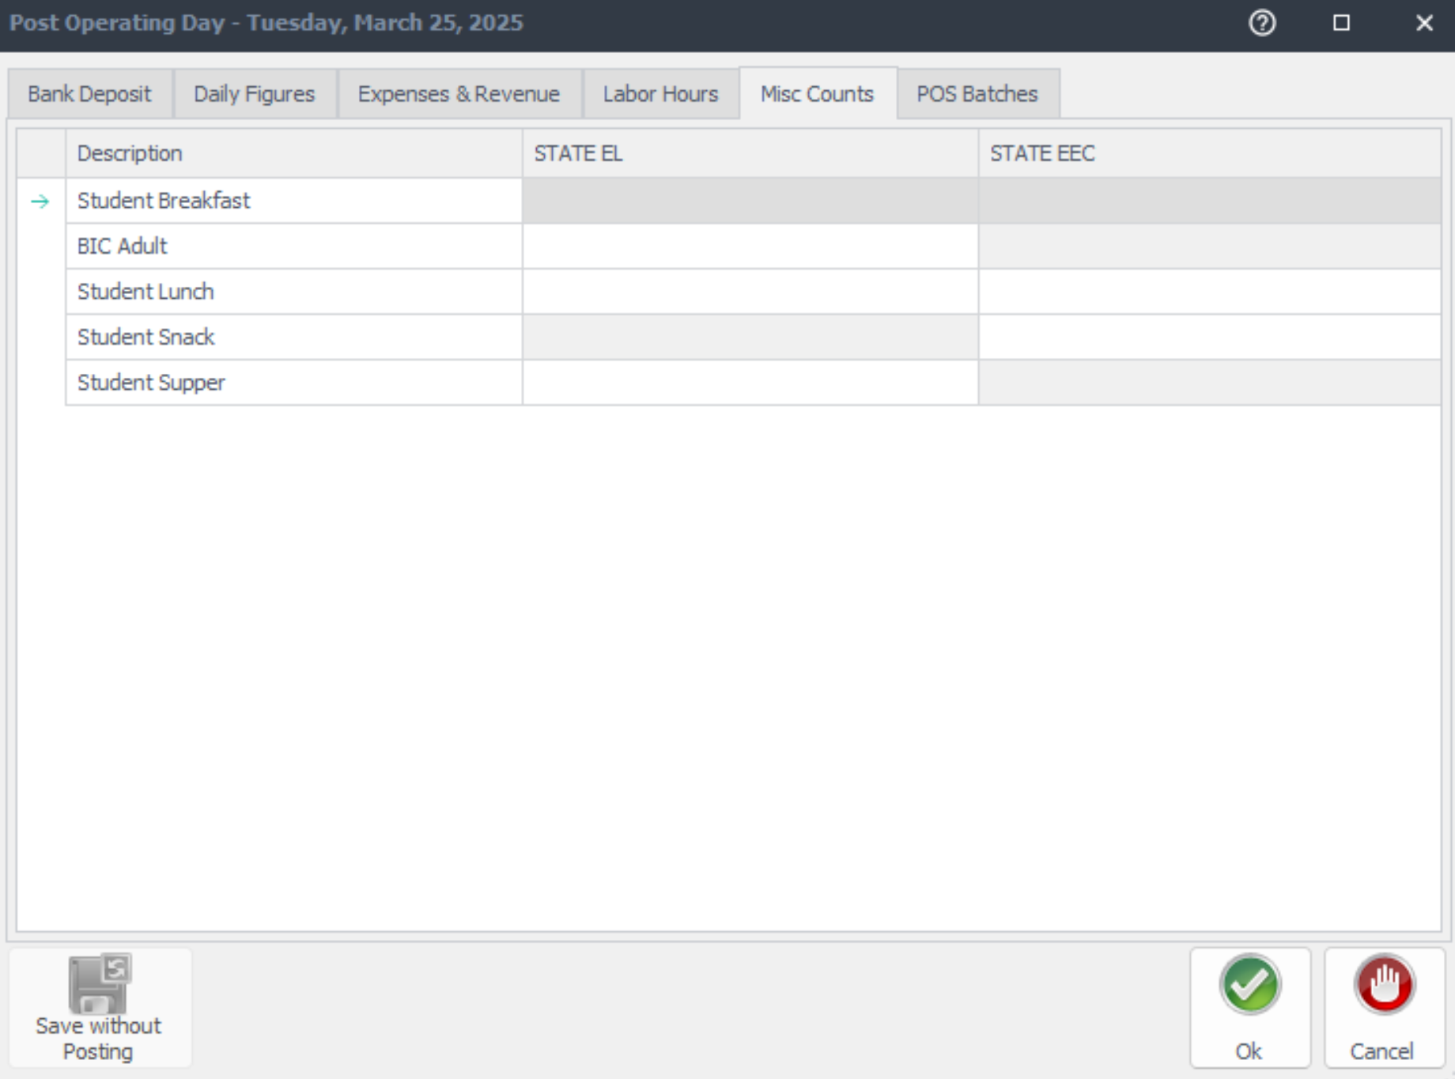
ENTERING MEALS IN NEWTON
Open the MISC Tab
Enter Meal Count numbers for the day
25
25
Re-open the Daily Figures Tab
Add comments then click “Reviewed”
Saturday service went perfectly. 25 students served.

Slide 42
ENTERING MEALS IN NEWTON
Lastly Click the green OK button and your day has been posted
Saturday service went perfectly. 25 students served.

Slide 43
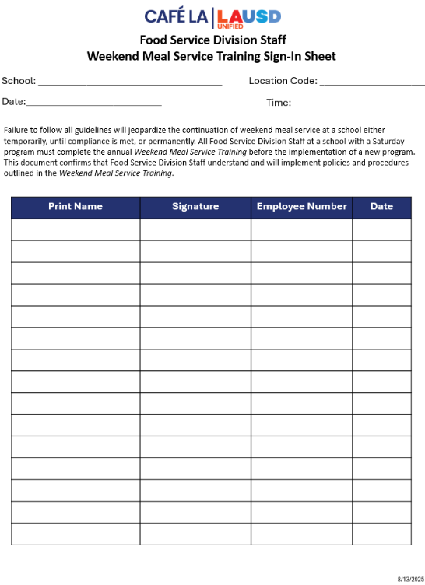
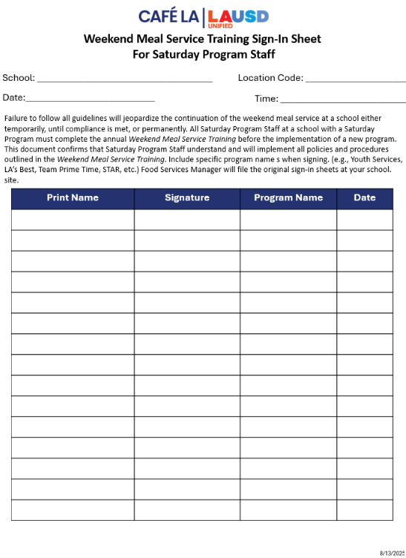
WEEKEND MEAL SERVICE TRAINING SIGN-IN SHEET
Food Service Division is required to provide annual Weekend Meal Service training to Food Service Managers and Saturday program staff before the implementation of a new Saturday Meal Program.

Slide 44
Summary
To recap this training has covered:
Program Rules.
Saturday Productions
Saturday Grid Sheets.
Identifying Reimbursable Meals.
Saturday Meal Service Compliant Checklist
CMS accountability

